Slide 1

Career Library Workflow
15-March-2026

Slide 2
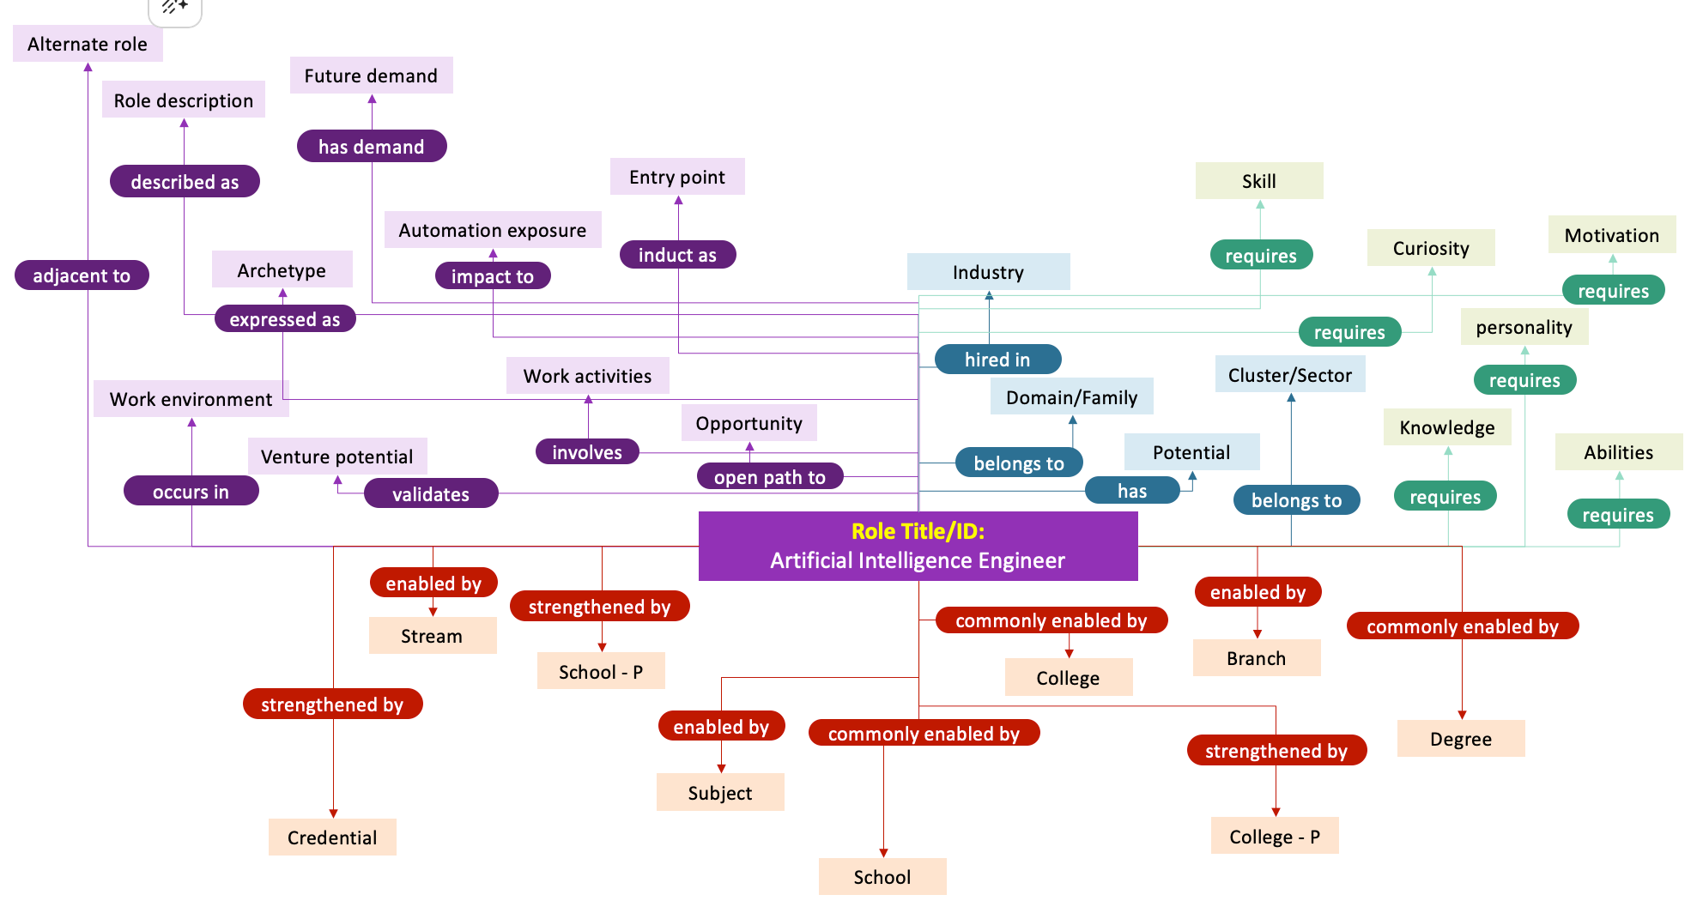

Slide 3


GETTING THE DATA
Role inventory
Identify a role
LLM I/P Template
Claude
Combined Data for Fields
Populate DB Fields
Data for Fields - 2
BUILDING THE DATABASE

Slide 4

Thank You

Slide 5
Alternate role
Future demand
Role description
has demand
described as
Entry point
Skill
Automation exposure
Motivation
induct as
requires
Curiosity
adjacent to
Archetype
impact to
Industry
requires
expressed as
requires
personality
Work activities
hired in
Cluster/Sector
Work environment
Domain/Family
requires
Opportunity
Knowledge
Venture potential
involves
belongs to
Potential
Abilities
occurs in
validates
open path to
has
belongs to
requires
Role Title/ID:
Artificial Intelligence Engineer
requires
enabled by
enabled by
strengthened by
commonly enabled by
Stream
commonly enabled by
School - P
Branch
College
strengthened by
enabled by
commonly enabled by
Degree
strengthened by
Subject
Credential
College - P
School

